Slide 1
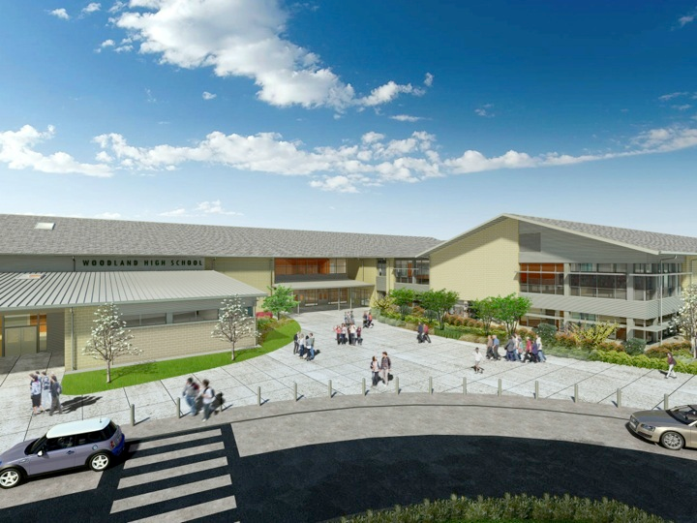
Woodland Public Schools
Facilities and Safety Report
February 2018

Slide 2
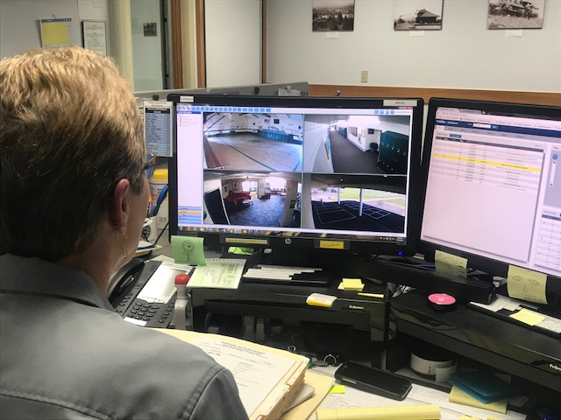
FACILITIES REPORT
Summer Planning Activities As we round the corner into April, summer planning activities are shifting into high gear. As with the previous two years, I will continue to focus the majority of activities and internal resources on hardening exterior finishes. This will include roofing, siding, blacktop sealing and mortar and brick sealing and repair. Contractors have been on site regularly over the past few weeks getting numbers put together for the majority of these jobs.
Solar System Moving Forward Solar World of Oregon is completing the MOU for the system they are supplying. They are offering the system heavily discounted at 20 cents a KW hour. I am soliciting other businesses in the area for donations of time and materials, and have already partnered with Fastenal and Christenson Electric for some of this. Once the final location and array arrangement is nailed down, and a few details are addressed with the PUD, we will be ready to start work.
Security Cameras at WPD The Woodland Police Department can
now quickly access each school’s camera system to pinpoint problem
areas within the schools and direct officers quickly to the scene.
WIS, WMS and WHS are currently available for viewing. Additional
ExacqVision software licenses were purchased to extend this service into
WPS. I expect this to be completed within the next few days. Many
thanks to Steve and the IT department, who have been giving me unparalleled
support in the integration of these systems throughout the schools. Special
recognition goes to Travis Borders for his outstanding work and support.
Woodland Police Dispatcher views 4 cameras at WMS

Slide 3
Facilities Report Continued
Florida School Tragedy With every school tragedy that occurs, I try to evaluate what weaknesses in physical security were found, and to see if those weaknesses are present at our Schools. A couple of items stood out.
Fire alarm pull stations were deployed to flush students and staff into hallways. With modernization of the International Fire Code (IFC), pull stations are not required if the schools have fire sprinklers and smoke detectors. This is why you don’t see them at WHS. I will remove them from the other schools once I have concurrence from the Fire Marshall. This will also aid in random student deployment of pull stations, although the security cameras have done a pretty good job policing that.
Opening doors/ gates prior to school ending- In Florida the assailant entered the school through normally locked gates. It was routine for the staff to unlock doors 30 minutes prior to school getting out, due to the number of exits they had to open. We also were doing this at one school. Direction has been given to not open gates until school is dismissed.
Drills to be announced as drills- The school had run a fire drill earlier in the day, and when the second alarm went off, students and staff thought the second alarm was related to the earlier drill. All Woodland Schools drills will be announced as drills prior to conducting the drill. This will ensure staff knows the true source of the alarm.
The District’s entire school safety program has been rewritten over the past year. We have done a relatively good job getting the office staff at each school trained, and school staff trained on basic incident response. But it seems like a lot of detailed information on ICS and reunification was not trickling down to school staff. To respond to this, I completed a more descriptive ppt. presentation for school staff. This was already given to the staff at WPS and WMS, and I expect the balance of the schools shortly . For parents and the community, I also posted on the school website the District’s reunification strategies, including a video for reunification.

Slide 4
Facilities Report Continued
Rekeying of WMS All exterior locks at the Woodland Middle School complex were changed in February. This same scenario will occur at the other schools over the next few months, to render the widely distributed A key useless.
Seismic Engineering Visit I have retained the engineering firm that did the high school seismic engineering, to look at a few of the buildings in the District. The purpose of this evaluation will be to understand our seismic vulnerability. I would expect it will lead to further proposals, to improve seismic bracing in specific buildings or areas used for shelter. At this point we need to understand the risk, should a major earthquake occur.

Slide 5
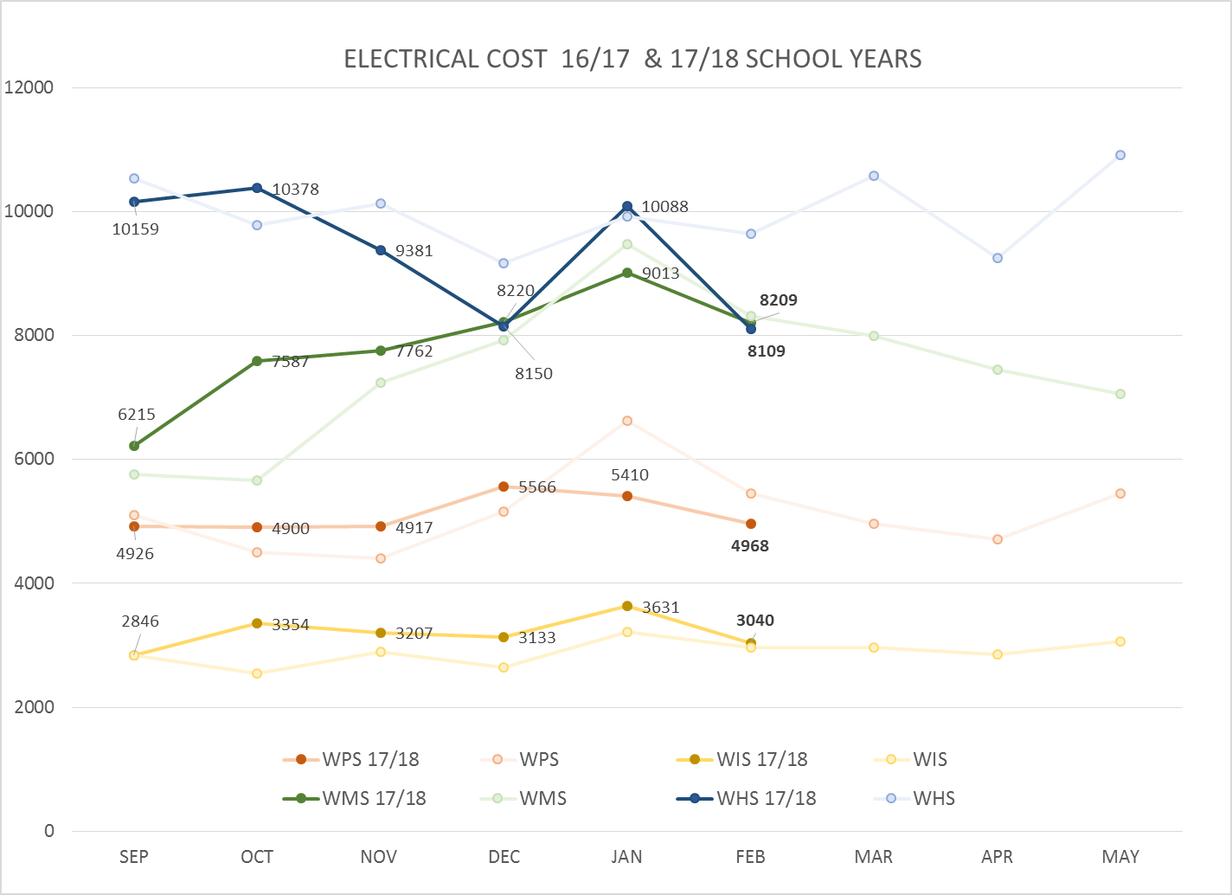
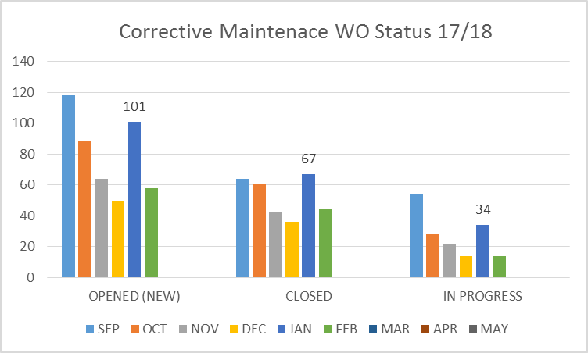
FACILITY CHARTS – POWER COST AND WORK ORDER STATUS

Slide 6
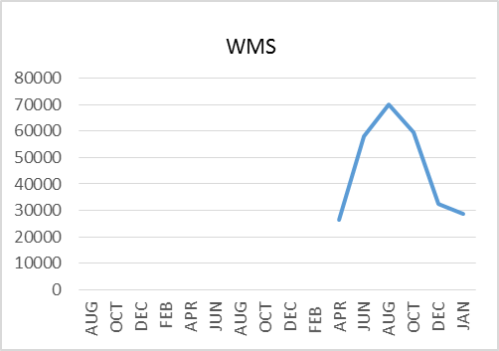
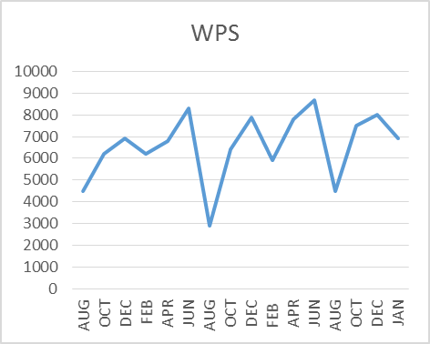
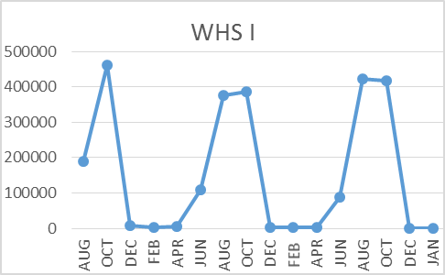
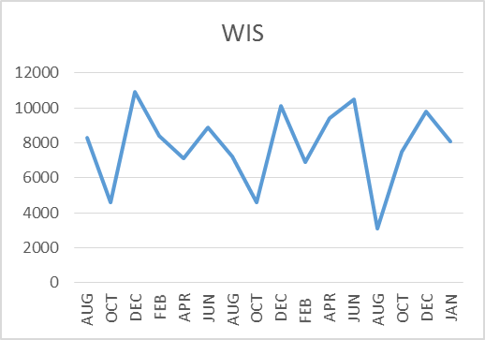
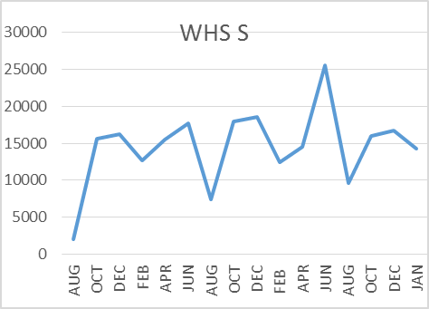
FACILITY CHARTS –
WATER USAGE
WHS, WIS, WMS, WPS
Water charts are updated every two
Months. The next update to these charts
in May 2018
The WMS chart includes; 755 park high and low flow, BO and Team High, PIT House, bus barn, athletic field and DO. All of these meters are totaled on the WMS graph, but each data point is recorded separately, to aid in identifying leaks.

Slide 7
SAFETY REPORT
Accidents/Incidents
There were 3 student and 25 staff incidents/accidents for the month.
Staff Accidents/Incidents
Yale School - Employee lost footing and fell
WPS - Student behavior 24 – Various minor injuries, bites, kicks, etc.
Student Accidents/Injuries (4)
WIS - Student tripped on shoelace, hit back of head
WIS – Student had seizure, 911 called
WIS - Student swinging on tetherball pole lost grip and fell, bruised cheek

Slide 8
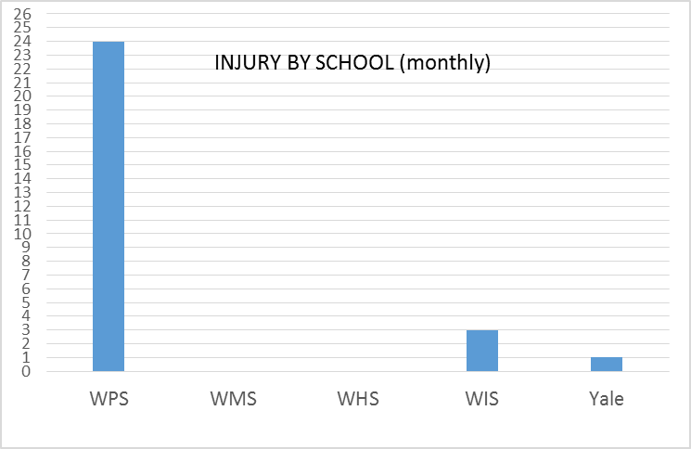
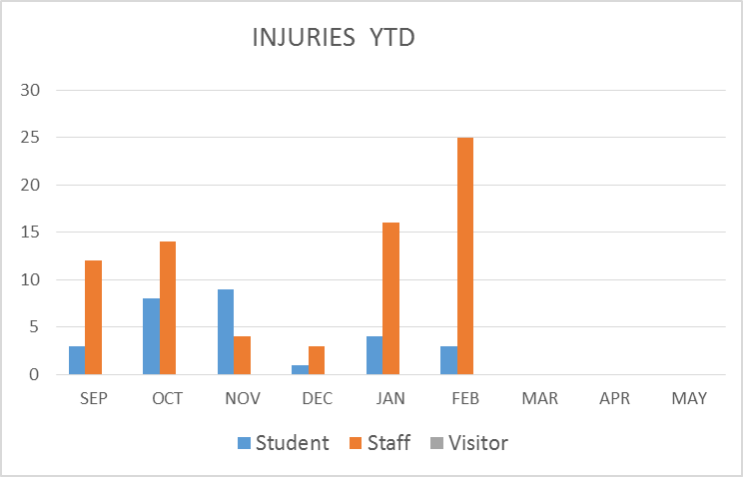
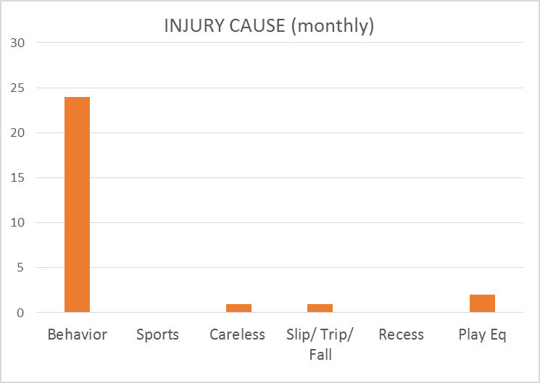
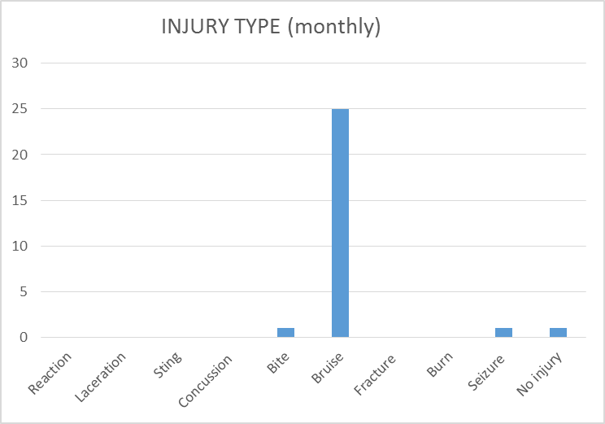
SAFETY CHARTS

